Slide 1

Euler And Hamiltonian Path Detector
Presenter:
Abdur Razzaq Siddiqui (21k-3200)
Syed Muneeb Ahmed (21k-3330)
Arham Mehmood (21k-3201)

Slide 2



Agenda
Introduction
Overview
Problem Statement
Methodology
Result
Real-World Applications
Conclusion

Slide 3




Introduction
In the realm of graph theory, Hamiltonian and Eulerian paths emerge as key concepts that unveil the mysteries of network connectivity. This project serves as a concise exploration into the significance of Hamiltonian and Eulerian paths, shedding light on their practical applications and the algorithms essential for their detection. Join us in this brief journey as we unravel the intricacies of traversing vertices and edges in graphs, uncovering the fundamental principles that underpin these intriguing path-finding phenomena.

Slide 4

Overview

Slide 5
Overview:
Our project centers on the implementation of Hamiltonian and Eulerian path detection algorithms using Python. Graph theory provides a powerful framework for understanding connectivity patterns, and Hamiltonian and Eulerian paths offer unique insights into traversing vertices and edges within a graph. In this exploration, we leverage the versatility of Python to demonstrate how these paths can be detected and analyzed efficiently. The project encompasses theoretical discussions, practical implementations, and illustrative examples, aiming to provide hands-on experience in solving graph-related problems using Python programming

Slide 6
Problem Statement

Slide 7
Problem Statement
In the realm of graph theory and network analysis, the efficient detection of Hamiltonian and Eulerian paths stands as a critical challenge. Navigating through the complexities of vertices and edges in a graph is essential for optimizing routes, understanding connectivity, and solving real-world problems. The absence of streamlined algorithms for Hamiltonian and Eulerian path detection hinders progress in fields such as logistics, transportation, and network design. This project addresses the need for robust, Python-based solutions to detect and analyze Hamiltonian and Eulerian paths, aiming to contribute to the development of practical tools for network optimization and traversal in various domains.

Slide 8

Exploring Hamiltonian Path: A Hamiltonian path in graph theory is a way to traverse a graph, touching each vertex exactly once. It's like finding a path that visits every "stop" in a network without revisiting any location. Hamiltonian paths have applications in various fields, from optimizing routes in transportation networks to understanding the connectivity of molecules in chemistry

Slide 9
Exploring Eulerian Path: Eulerian path is a trail in a graph that visits every edge exactly once, but may not necessarily start and end at the same vertex. In other words, an Eulerian path traverses all edges of the graph without lifting the pen from the paper and without retracing any edge, but it doesn't have the constraint of returning to the starting point. If the Eulerian path does return to the starting vertex, it is then referred to as an Eulerian circuit. Both Eulerian paths and circuits are concepts central to the study of graph theory and have various applications in real-world problem-solving scenarios.

Slide 10
Real World Applications

Slide 11

Real-world Application of Hamiltonian Path: Logistics and Route Optimization: In logistics and delivery systems, finding a Hamiltonian path optimizes routes for vehicles, minimizing travel time and costs. Robotics and Automated Systems: Hamiltonian paths are used in robotics for path planning, ensuring robots cover an entire workspace without revisiting any location. Game Theory: In certain games and puzzles, Hamiltonian paths represent a challenge, such as in a game board where the path signifies a series of valid moves. Tour Planning and Sightseeing: In tourism, Hamiltonian paths can be applied to plan sightseeing tours, optimizing the travel experience by visiting each point of interest exactly once. Genome Sequencing: In bioinformatics, Hamiltonian paths are employed for genome sequencing, contributing to the understanding of genetic structures and variations. Printed Circuit Board (PCB) Manufacturing: Hamiltonian circuits play a role in designing printed circuit boards, ensuring efficient connections between electronic components in the manufacturing process.

Slide 12

Real-world Application of Euler Path: Circuit Design: Eulerian circuits find applications in electronic circuit design, creating closed loops to ensure every component is connected without duplication. Network Connectivity: In telecommunication networks, Eulerian paths ensure efficient data transmission by utilizing every connection without repetition. Traffic Management: Eulerian paths are applied in traffic management systems, optimizing traffic flow by ensuring each intersection and road segment is traversed efficiently. Chemistry and Molecular Structures: In chemistry, Eulerian paths are used to model molecular structures, aiding in drug discovery and the study of chemical reactions.

Slide 13

Complexity and Scalability:
The complexity and scalability of Hamiltonian and Eulerian path detection algorithms depend on various factors, including the type and size of the graph, its density, and the specific problem requirements. Striking a balance between computational efficiency and accuracy is crucial, and the project may involve exploring optimization techniques and considering the practical implications of applying these algorithms to real-world scenarios.

Slide 14
Eulerian Path Visualization

Slide 15








Eulerian Path:

Slide 16
Eulerian Path:

Slide 17
Eulerian Path:

Slide 18
Eulerian Path:

Slide 19
Eulerian Path:

Slide 20
Eulerian Path:

Slide 21
Eulerian Path:

Slide 22
Eulerian Path:

Slide 23
Hamiltonian Path Visualization

Slide 24
Hamiltonian path:

Slide 25
Hamiltonian path:

Slide 26
Hamiltonian path:

Slide 27
Hamiltonian path:

Slide 28
Hamiltonian path:

Slide 29
Hamiltonian path:

Slide 30
Methodology (code implementation)

Slide 31
Eulerian code

Slide 32
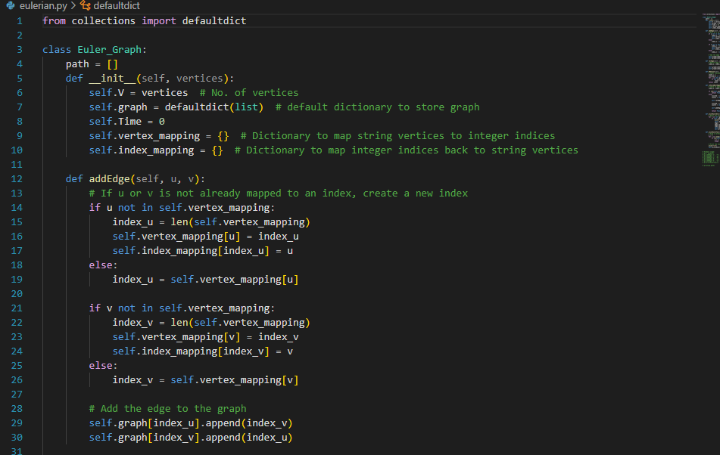

Slide 33
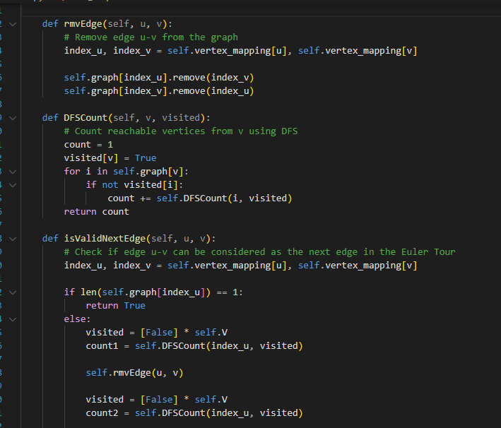

Slide 34
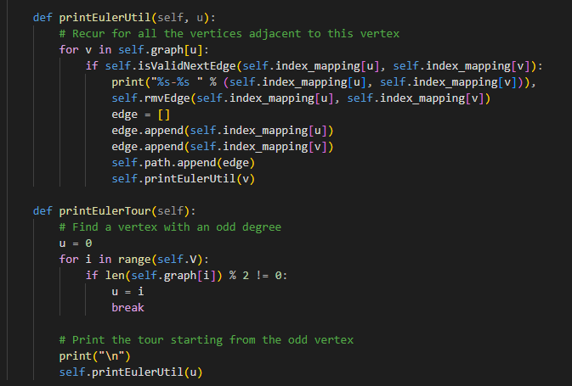

Slide 35
Hamiltonian code

Slide 36
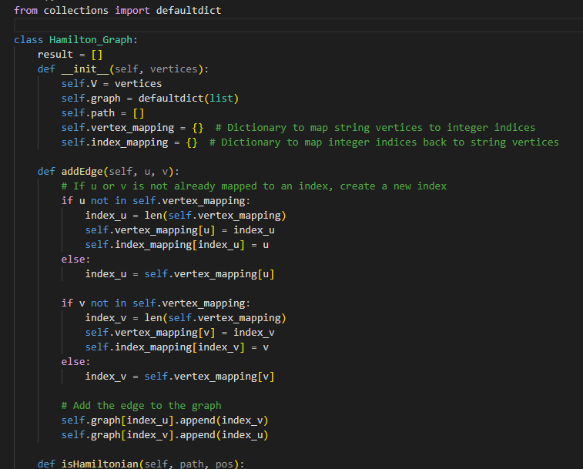

Slide 37
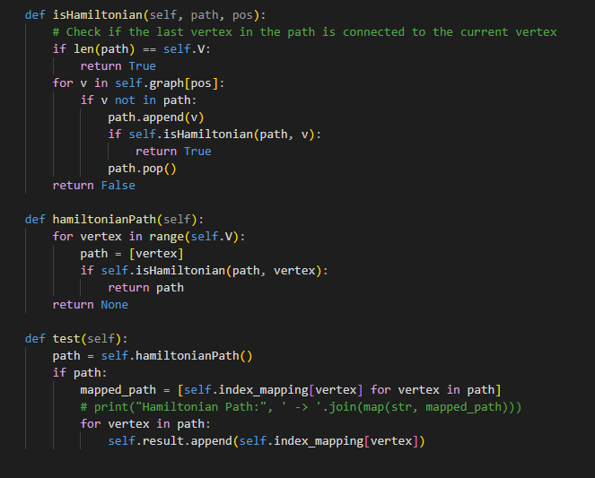

Slide 38
Result

Slide 39

Eulearian graphical representation:

Slide 40
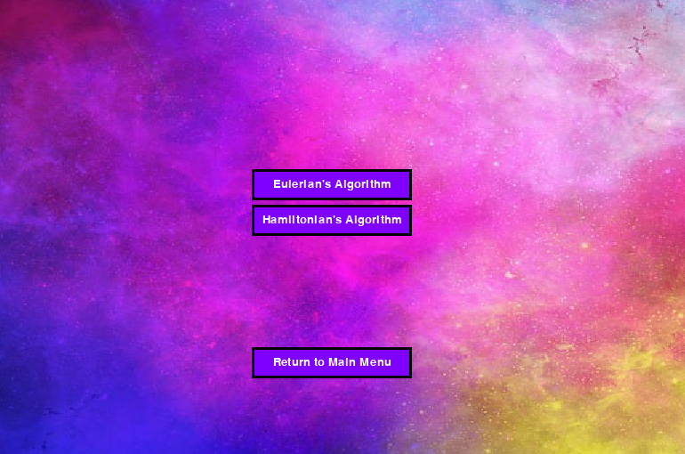

Slide 41
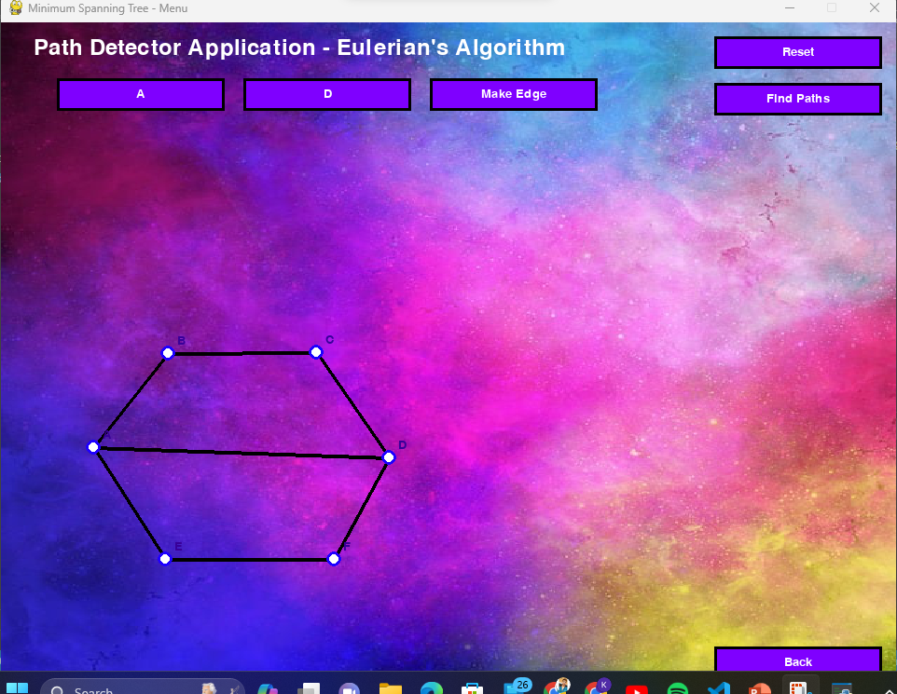

Slide 42
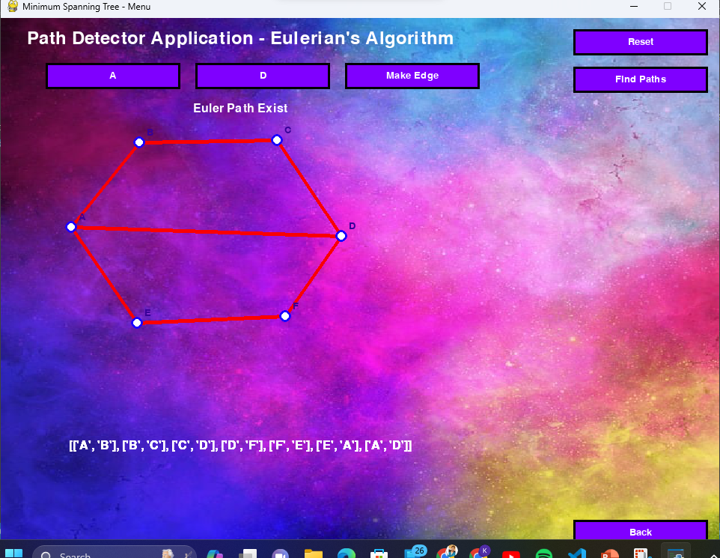

Slide 43
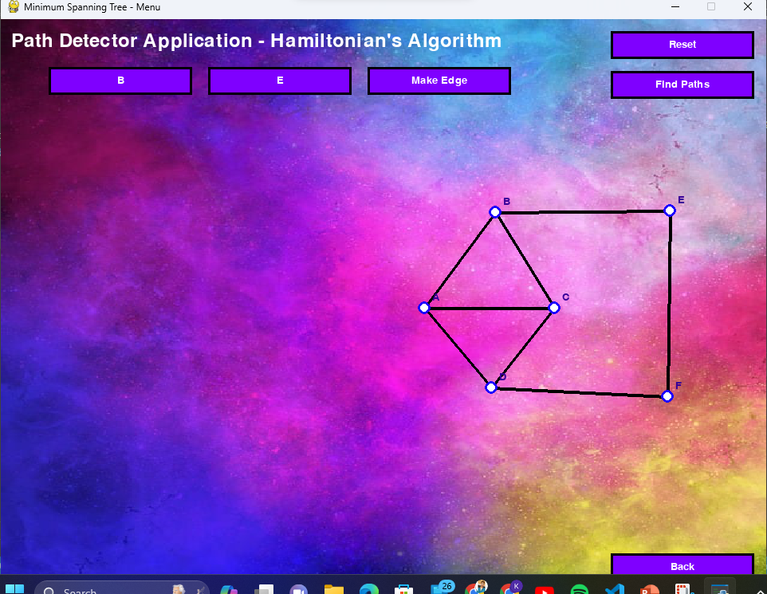
Hamiltonian representatin

Slide 44
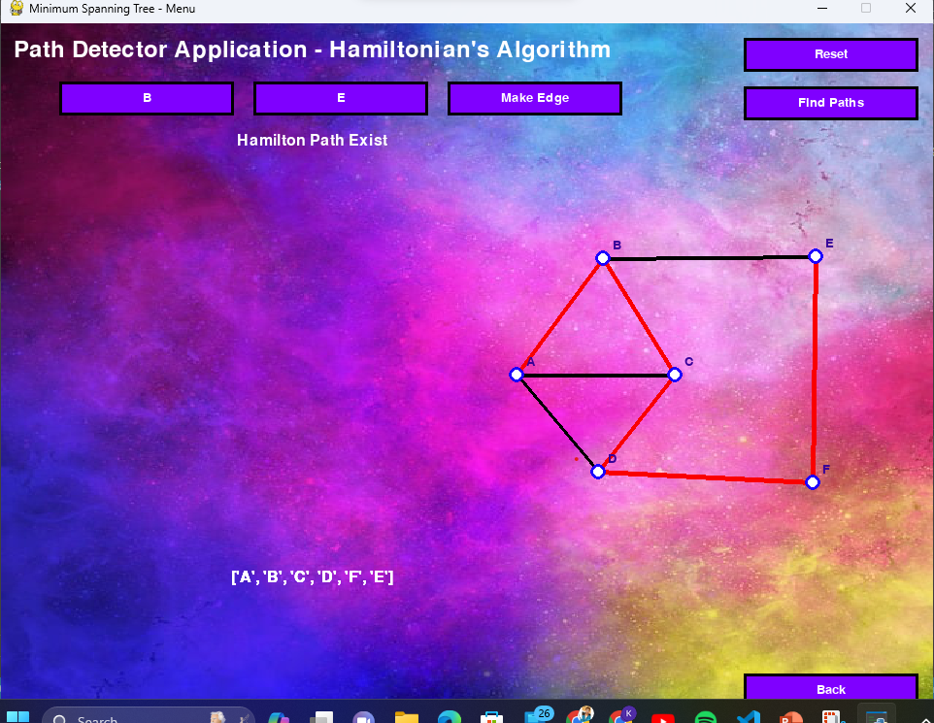

Slide 45
Complexity and Scalability:
The complexity and scalability of Hamiltonian and Eulerian path detection algorithms depend on various factors, including the type and size of the graph, its density, and the specific problem requirements. Striking a balance between computational efficiency and accuracy is crucial, and the project may involve exploring optimization techniques and considering the practical implications of applying these algorithms to real-world scenarios.

Slide 46
Conclusion

Slide 47
Conclusion:
In essence, the journey through Hamiltonian and Eulerian paths has not only expanded our understanding of graph theory but has also opened doors to innovative solutions in fields where network analysis plays a pivotal role. By bridging theory with practical applications, this project invites continued exploration into the intricate world of graph traversal, where the possibilities are as vast as the networks we seek to understand and optimize.

Slide 48


Thank You

